Slide 1

EECS 370 - Lecture 22
Multi-Level Page Tables
Live Poll + Q&A: slido.com #eecs370
Poll and Q&A Link

Slide 2
Announcements
P4
Last project!
Due Thu (4/13)
HW 6
Last homework!
Due Monday (4/17)
Final exam
…Last exam!
Thu (4/20) @ 10:30 am
Sample exams will be posted by early next week
(One sample exam given in homework)

Slide 3
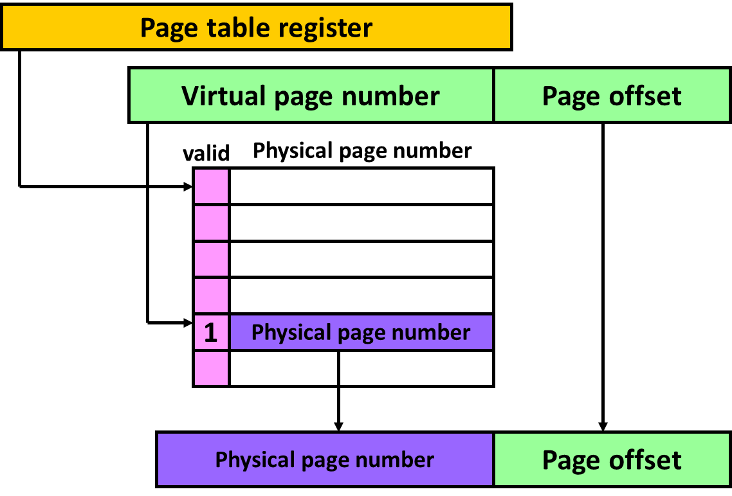
Reminder
We use a “page table” to translate “virtual” addresses (specified by the programmer / assembler) to “physical” addresses (sent to memory)
Allows multiple programs to run without interfering with each other
Allows programs to use more storage than available in DRAM
By mapping virtual addresses to disk instead of DRAM

Slide 4
Class Problem (continued)
4KB page size,
physical memory of 16KB, page table stored in physical page 0 and can never be evicted, 20 bit, byte-addressable virtual address space.
The page table initially has virtual page 0 in physical page 1, virtual page 1 in physical page 2 and no valid data in other physical pages.
Virt addr | Virt page | Page fault? | Phys addr
0x00F0C | 0x0 | N | 0x1F0C
0x01F0C | 0x1 | N | 0x2F0C
0x20F0C | 0x20 | Y (into 3) | 0x3F0C
0x00100 | 0x0 | N | 0x1100
0x00200 | 0x0 | N | 0x1200
0x30000 | 0x30 | Y (into 2) | 0x2000
0x01FFF | 0x1 | Y (into 3) | 0x3FFF
0x00200 | 0x0 | N | 0x1200

Slide 5
Size of the page table
How big is a page table entry?
For 32-bit virtual address:
If the machine can support 1GB = 2³⁰ bytes of physical memory and we use pages of size 4KB = 2¹²,
then the physical page number is 30-12 = 18 bits. Plus another valid bit + other useful stuff (read only, dirty, etc.)
Let say about 3 bytes.
How many entries in the page table?
1 entry per virtual page
ARM virtual address is 32 bits – 12 bit page offset = 20
Total number of virtual pages = 2²⁰
Total size of page table = Number of virtual pages
* Size of each page table entry
= 2²⁰ ^{x} 3 bytes ~ 3 MB

Slide 6
How can you organize the page table?
Single-level page table occupies continuous region in physical memory
Previous example always takes 3MB regardless of how much virtual memory is used
valid
A small program will use up 3MB to store just one PPN!!
1
Physical page number
It will be even worse for a 64-bit system!
…

Slide 7
How can you organize the page table?
Option 2: Use a multi-level page table
1st level page table (much smaller!) holds addresses 2nd level page tables
2nd level page tables hold translation info, or 3rd level page tables if we wanna go deeper
Only allocate space for 2nd level page tables that are used
valid | PPN
1 | 0x1
1 | 0x2
1 | 0x3
valid | 2nd level page table
1 | 0x1000
valid | PPN
1 | 0x1
1 | 0x2
1 | 0x3
Multi-level: Size is proportional to amount of memory used
Single-level: Tons of wasted space!
Common case: most programs use small portion of virtual memory space

Slide 8
Hierarchical page table
Page table register
Virtual
address
1st level offset
2nd level offset
Page offset
valid
1st level page table
valid
2nd level page table
+
1
Physical page number
+
1
2nd level page table
Only allocate space for the 2nd level page tables we actually need
Fewer entries in 1st level page table than a single level page table
Physical
address
Physical page number
Page offset

Slide 9
Hierarchical page table – 32bit Intel x86
Virtual
address
1st level offset
2nd level offset
Page offset
31
21
11
10
10
12
2¹⁰=1024
How many bits in the virtual 1st level offset field?
How many bits in the virtual 2nd level offset field?
How many bits in the page offset?
How many entries in the 1st level page table?
1st level offset
valid
1st level page table
1
2nd level page table

Slide 10
Hierarchical page table – 32bit Intel x86
Live Poll + Q&A: slido.com #eecs370
Poll
Virtual
address
1st level offset
2nd level offset
Page offset
31
21
11
How many bytes for each entry in the 1st level page table?
4 bytes (address of 2nd level page)
Total size of 1st level page table
4 bytes * 1024 entries = 4 KB
4 bytes
1st level offset
valid
1st level page table
1024 entries
1
2nd level page table

Slide 11
Hierarchical page table
How many entries in the 2nd level of the page table?
2¹⁰ = 1024
How many bytes for each VPN in a 2nd level table?
Let's round up to 4 bytes
1st level offset
2nd level offset
Page offset
Virtual
address
31
21
11
valid
1st level page table
valid
2nd level page table
+
1
Physical page number
+
1
2nd level page table

Slide 12
Hierarchical page table – 32bit Intel x86
Virtual
address
1st level offset
2nd level offset
Page offset
31
21
11
How many bits in the virtual 1st level offset field?
How many bits in the virtual 2nd level offset field?
How many bits in the page offset?
How many entries in the 1st level page table?
How many bytes for each entry in the 1st level page table?
How many entries in the 2nd level of the page table?
How many bytes for each entry in a 2nd level table?
What is the total size of the page table?
(here n is number of valid entries in the 1st level page table)
Live Poll + Q&A: slido.com #eecs370

Slide 13
Hierarchical page table – 32bit Intel x86
Virtual
address
1st level offset
2nd level offset
Page offset
31
11
10
10
12
2¹⁰=1024
4
2¹⁰=1024
~4
21
How many bits in the virtual 1st level offset field?
How many bits in the virtual 2nd level offset field?
How many bits in the page offset?
How many entries in the 1st level page table?
How many bytes for each entry in the 1st level page table?
How many entries in the 2nd level of the page table?
How many bytes for each entry in a 2nd level table?
What is the total size of the page table?
(here n is number of valid entries in the 1st level page table)
4K+n*4K

Slide 14
Class Problem (32 bit x86)
Poll
What is the least amount of memory that could be used? When would this happen?
What is the most memory that could be used? When would this happen?
How much memory is used for this memory access pattern: 0x00000ABC 0x00000ABD 0x10000ABC 0x20000ABC
How much memory if we used a single-level page table with 4KB pages? Assume entries are rounded to the nearest word (4B)
Live Poll + Q&A: slido.com #eecs370

Slide 15
Class Problem (32 bit x86)
What is the least amount of memory that could be used? When would this happen?
4KB for 1st level page table. Occurs when no memory has been accessed (before program runs)
What is the most memory that could be used? When would this happen?
4KB for 1st level page table + 1024*4KB for all possible 2nd level page tables = 4100KB (which slightly greater than 4096KB)
Occurs when program uses all virtual pages (= 2²⁰ pages)

Slide 16
Class Problem (32 bit x86)
How much memory is used for this memory access pattern:
0x00000ABC // Page fault 0x00000ABD 0x10000ABC // Page fault 0x20000ABC // Page fault
4KB for 1st level page table + 3*4KB for each 2L page table = 16 KB

Slide 17
Class Problem (32 bit x86)
How much memory if we used a single-level page table with 4KB pages? Assume entries are rounded to the nearest word (4B)

Slide 18
Class Problem (32 bit x86)
How much memory if we used a single-level page table with 4KB pages? Assume entries are rounded to the nearest word (4B)
32 bits – 12 bit page offset = 20 bits of address
2^20 (num entries) * 4B => 4MB

Slide 19
Class Problem – Multi-level VM
Design a two-level virtual memory system of a byte addressable processor with 24-bit long addresses. No cache in the system. 256Kbytes of memory installed, and no additional memory can be added.
Virtual memory page: 512 Bytes. Each page table entry must be an integer number of bytes, and must be the smallest size required to fit the physical page number + 1 bit to mark valid-entry
We want each second-level page table to fit exactly in one memory page, and 1st level page table entries are 3 bytes each (a memory address pointer to a 2L page table).
Compute:
Number of entries in each 2nd level page table;
Number of virtual address bits used to index the 2nd level page table;
Number of virtual address bits used to index the 1st level page table;
Size of the 1st level page table.

Slide 20
Class Problem – Multi-level VM

Slide 21
Class Problem – Multi-level VM
Page Offset: 9 bits (512B page size)
Physical address = 18b (256KB Mem size)
Physical page number = 18b (256KB mem size) – 9b (offset)
Physical page number = 9b
Page offset = 9b
2nd level page table entry size: 9b (physical page number) + 1b =~ 2 bytes
2nd level page table fits exactly in 1 page
#entries in 2nd level page table is 512 bytes / 2 bytes = 256
#entries in 2nd level page table = 256 ➜Virtual page bits = 8b
Virtual 1st level page bits = 24 – 8 – 9 = 7b
1st level page table size = 2^7 * 3 bytes = 384B
1st level = 7b
2nd level = 8b
Page offset = 9b
Virtual address = 24b

Slide 22
Page Replacement Strategies
Page table indirection enables a fully associative mapping between virtual and physical pages.
How do we implement LRU in OS?
True LRU is expensive, but LRU is a heuristic anyway, so approximating LRU is fine
Keep a “accessed” bit per page, cleared occasionally by the operating system. Then pick any “unaccessed” page to evict

Slide 23
Other VM Translation Functions
Page data location
Physical memory, disk, uninitialized data
Access permissions
Read only pages for instructions
This is how your system detects segmentation faults
Gathering access information
Identifying dirty pages by tracking stores
Identifying accesses to help determine LRU candidate

Slide 24
Performance of Virtual Memory
To translate a virtual address into a physical address, we must first access the page table in physical memory
Then we access physical memory again to get the data
A load instruction performs at least 2 memory reads
A store instruction performs at least 1 read and then a write
Above lookup steps are SLOW

Slide 25
Translation look-aside buffer (TLB)
We fix this performance problem by avoiding main memory in the translation from virtual to physical pages.
Buffer common translations in a Translation Look-aside Buffer (TLB), a fast cache memory dedicated to storing a small subset of valid V-to-P translations.
16-512 entries common.
Generally has low miss rate (< 1%).

Slide 26
Translation look-aside buffer (TLB)
Virtual page
Pg offset
Virtual address
v
tag
Physical page
TLB

Slide 27
Where is the TLB lookup?
We put the TLB lookup in the pipeline after the virtual address is calculated and before the memory reference is performed
This may be before or during the data cache access.
To be discussed next time
In case of a TLB miss, we need to perform the virtual to physical address translation during the memory stage of the pipeline.

Slide 28
Putting it all together
Loading your program in memory
Ask operating system to create a new process
Construct a page table for this process
Mark all page table entries as invalid with a pointer to the disk image of the program
That is, point to the executable file containing the binary.
Run the program and get an immediate page fault on the first instruction.

Slide 29
Loading a program into memory
Page size = 4 KB, Page table entry size = 4 B
Page table register points to physical address 0x0000
Disk Pages
Memory
2 entry TLB
VPN PPN Permission
D0
D1
D2
D3
Page Table
0
Physical Refs
References
0x0000
0x0004
0x7FFC
0x0008
0x2134
1
2
D1000
text1
3
D1001
text2
4
D1002
global data
5
D1003
6
7

Slide 30
Step 1: Read executable header & initialize page table
Disk Pages
Memory
2 entry TLB
VPN PPN Permission
D0
reserved
D1
D2
D3
Page Table
0
D1000
ro
Physical Refs
References
0x0000
0x0004
0x7FFC
0x0008
0x2134
1
D1001
ro
2
D1002
D1000
text1
no map
3
D1001
text2
no map
4
D1002
global data
no map
5
D1003
no map
6
7
no map

Slide 31
Step 2: Load PC from header & start execution
Disk Pages
Memory
2 entry TLB
VPN PPN Permission
D0
reserved
MISS!
D1
D2
D3
Page Table
0
D1000
ro
Physical Refs
References
0x0000
0x0004
0x7FFC
0x0008
0x2134
1
D1001
ro
2
D1002
D1000
text1
no map
3
D1001
text2
no map
4
D1002
global data
no map
5
D1003
no map
6
7
no map

Slide 32
Fetching instruction 0000
Disk Pages
Memory
2 entry TLB
VPN PPN Permission
D0
reserved
D1
D2
D3
Page Table
0
D1000
ro
Physical Refs
0x0000
Page fault
References
0x0000
0x0004
0x7FFC
0x0008
0x2134
1
D1001
ro
2
D1002
D1000
text1
no map
3
D1001
text2
no map
4
D1002
global data
no map
5
D1003
no map
6
7
no map

Slide 33
Fetching instruction 0000
Disk Pages
Memory
2 entry TLB
VPN PPN Permission
D0
reserved
0
M1
ro
D1
text1
D2
D3
Page Table
0
M1
ro
Physical Refs
0x0000
Page fault
References
0x0000
0x0004
0x7FFC
0x0008
0x2134
1
D1001
ro
2
D1002
D1000
text1
no map
3
D1001
text2
no map
4
D1002
global data
no map
5
D1003
no map
6
7
no map

Slide 34
Fetching instruction 0000
Disk Pages
Memory
2 entry TLB
VPN PPN Permission
D0
reserved
0
M1
ro
D1
text1
D2
D3
Page Table
0
M1
ro
Physical Refs
0x0000
Page fault
0x1000
References
0x0000
0x0004
0x7FFC
0x0008
0x2134
1
D1001
ro
2
D1002
D1000
text1
no map
3
D1001
text2
no map
4
D1002
global data
no map
5
D1003
no map
6
7
no map

Slide 35
Fetching instruction 0004
Disk Pages
Memory
2 entry TLB
VPN PPN Permission
D0
reserved
0
M1
ro
HIT!
D1
text1
D2
D3
Page Table
0
M1
ro
Physical Refs
0x0000
Page fault
0x1000
0x1004
References
0x0000
0x0004
0x7FFC
0x0008
0x2134
1
D1001
ro
2
D1002
D1000
text1
no map
3
D1001
text2
no map
4
D1002
global data
no map
5
D1003
no map
6
7
no map

Slide 36
Reference 7FFC
Disk Pages
Memory
2 entry TLB
VPN PPN Permission
D0
reserved
0
M1
ro
D1
MISS!
text1
D2
D3
Page Table
0
M1
ro
Physical Refs
0x0000
Page fault
0x1000
0x1004
References
0x0000
0x0004
0x7FFC
0x0008
0x2134
1
D1001
ro
2
D1002
D1000
text1
no map
3
D1001
text2
no map
4
D1002
global data
no map
5
D1003
no map
6
7
no map

Slide 37
Reference 7FFC
Disk Pages
Memory
2 entry TLB
VPN PPN Permission
D0
reserved
0
M1
ro
D1
text1
D2
D3
Page Table
0
M1
ro
Physical Refs
0x0000
Page fault
0x1000
0x1004
0x0007
No map page fault
References
0x0000
0x0004
0x7FFC
0x0008
0x2134
1
D1001
ro
2
D1002
D1000
text1
no map
3
D1001
text2
no map
4
D1002
global data
no map
5
D1003
no map
6
7
no map

Slide 38
Reference 7FFC
Disk Pages
Memory
2 entry TLB
VPN PPN Permission
D0
reserved
0
M1
ro
D1
text1
7
M2
rw
D2
set to 0s
D3
Page Table
0
M1
ro
Physical Refs
0x0000
Page fault
0x1000
0x1004
0x0007
No map page fault
0x2FFC
References
0x0000
0x0004
0x7FFC
0x0008
0x2134
1
D1001
ro
2
D1002
D1000
text1
no map
3
D1001
text2
no map
4
D1002
global data
no map
5
D1003
no map
6
7
M2

Slide 39
Fetching instruction 0008
Disk Pages
Memory
2 entry TLB
VPN PPN Permission
D0
reserved
0
M1
ro
HIT!
D1
text1
7
M2
rw
D2
set to 0s
D3
Page Table
0
M1
ro
Physical Refs
0x0000
Page fault
0x1000
0x1004
0x0007
No map page fault
0x2FFC
0x1008
References
0x0000
0x0004
0x7FFC
0x0008
0x2134
1
D1001
ro
2
D1002
D1000
text1
no map
3
D1001
text2
no map
4
D1002
global data
no map
5
D1003
no map
6
7
M2

Slide 40
Reference 2134
Disk Pages
Memory
2 entry TLB
VPN PPN Permission
D0
reserved
0
M1
ro
MISS!
D1
text1
7
M2
rw
D2
set to 0s
D3
Page Table
0
M1
ro
Physical Refs
0x0000
Page fault
0x1000
0x1004
0x0007
No map page fault
0x2FFC
0x1008
References
0x0000
0x0004
0x7FFC
0x0008
0x2134
1
D1001
ro
2
D1002
D1000
text1
no map
3
D1001
text2
no map
4
D1002
global data
no map
5
D1003
no map
6
7
M2

Slide 41
Reference 2134
Disk Pages
Memory
2 entry TLB
VPN PPN Permission
D0
reserved
0
M1
ro
D1
text1
7
M2
rw
D2
set to 0s
D3
Page Table
0
M1
ro
Physical Refs
0x0000
Page fault
0x1000
0x1004
0x0007
No map page fault
0x2FFC
0x1008
0x0002
Page fault
References
0x0000
0x0004
0x7FFC
0x0008
0x2134
1
D1001
ro
2
D1002
D1000
text1
no map
3
D1001
text2
no map
4
D1002
global data
no map
5
D1003
no map
6
7
M2

Slide 42
Reference 2134
Disk Pages
Memory
2 entry TLB
VPN PPN Permission
D0
reserved
0
M1
ro
D1
text1
2
M3
rw
D2
set to 0s
D3
global data
Page Table
0
M1
ro
Physical Refs
0x0000
Page fault
0x1000
0x1004
0x0007
No map page fault
0x2FFC
0x1008
0x0002
Page fault
0x3134
References
0x0000
0x0004
0x7FFC
0x0008
0x2134
1
D1001
ro
2
M3
D1000
text1
no map
3
D1001
text2
no map
4
D1002
global data
no map
5
D1003
no map
6
7
M2

Slide 43

Next time
Speeding up virtual memory
Adding caches
Wrap up class!
Lingering questions / feedback? I'll include an anonymous form at the end of every lecture: https://bit.ly/3oXr4Ah

